Slide 1
Systems Analysis and Design
Chapter Two:
SDLC - Identification, Selection, and Planning phase

Slide 2
The Planning Phase
The first phase of SDLC
Consists of
Project identification and selection
Project initiation and planning

Slide 3
1. Identifying and Selecting Projects
Organizations can benefit from following a formal process.
The first activity of the systems planning and selection phase of the SDLC is project identification and selection.
Project identification and selection consists of:
Identifying potential development projects
Classifying and ranking projects
Selecting projects for development

Slide 4
Identifying Potential Development Projects
Organizations vary as to how they identify projects. Projects are identified by:
Top management
Steering committee (composed of a cross section of managers with an interest in systems)
User departments (head of the requesting unit or committee from the requesting department decides which projects to submit)
Development group or senior IS staff
Identification Approaches
Top-Down Identification
Senior management or steering committee
Focus is on global needs of organization
A strategic organizational focus
Largest project size, …

Slide 5
Identifying Potential Development Projects
Bottom-Up Identification
Business unit or IS group
Don’t reflect overall goals of the organization
Narrow, non strategic focus
Focuses on particular business need
Faster development, …

Slide 6
Classifying and Ranking IS Development Projects
Assessing the merit of potential projects is the second major activity in the project identification and selection phase.
The criteria used to evaluate projects usually varies by organization
Possible evaluation criteria when classifying and ranking projects(prioritizing) are:
Value chain analysis
Strategic alignment
Potential benefits
Resource availability
Project size/duration
Technical risk/difficulty

Slide 7
Classifying and ranking IS development projects
Value chain analysis
Extent to which activities add value and costs when developing products and/or services.
helps to understand how an IS project will impact different parts of the organization’s value chain. Each project can be evaluated based on primary and support activities:
Primary Activities: Does the IS project directly improve operations, customer service, or logistics? For example, an enterprise resource planning (ERP) system might streamline operations or improve procurement.
Support Activities: Does the IS project enhance support functions like HR or technology development? For instance, a project that improves data management or IT infrastructure could support the entire organization.
The higher the impact the higher the priority; or Information systems projects providing the greatest benefit to the value chain will be given priority over those with fewer benefits.
An important method.

Slide 8
Classifying and ranking IS development projects
Strategic alignment
Extent to which the project is viewed as helping the organization achieve its strategic objectives and long-term goals.
how well does a project align with the organization’s long-term goals and objectives
An IS project that aligns closely with the company’s strategic goals will have a higher priority.
Potential Benefits
Extent to which the project is viewed as improving profits, customer service, and so forth, and the duration of these benefits
evaluates the tangible and intangible benefits of the IS project
Financial benefits: Cost savings, increased revenue, improved productivity.
Operational benefits: Improved efficiency, reduced downtime, or enhanced service delivery.
Competitive advantage: Projects that provide differentiation in the market or offer innovative solutions.
Projects with significant business value, either through direct financial returns or through enhancing the company’s market position will have higher priority.

Slide 9
Classifying and ranking IS development projects
Resource availability
Amount and type of resources the project requires and their availability
Evaluate whether the necessary resources such as budget, technology, and skilled personnel are available to successfully complete the project
Projects where all necessary resources are readily available, reducing the risk of delays or cost overruns will have higher priority
Project size/duration
Assess the scope and timeline of the project. A large, long-term IS project may provide significant benefits but could also come with higher risks due to its complexity and length
Projects with manageable size and duration, allowing for quicker returns and reduced complexity may have higher priority
Technical risk/difficulty
Level of technical difficulty to successfully complete the project within given time and resource constraints
Assess the challenges associated with the project’s implementation, including the complexity of the technology, integration with existing systems, or the availability of the required technical expertise
Projects whose technical requirement matches teams’ expertise that reduce the risk of failure will be of higher priority

Slide 10
Selecting IS development projects
The selection of projects is the final activity in the project identification and selection phase.
selection is a process of considering both short- and long-term projects and selecting those most likely to achieve business objectives.
As business conditions change over time, the relative importance of any single project may substantially change.
the identification and selection of projects is a very important and ongoing activity.
Numerous factors are considered when selecting a project including:
Perceived needs of the organization
Existing systems and ongoing projects
Resource availability
Evaluation criteria
Current business conditions

Slide 11
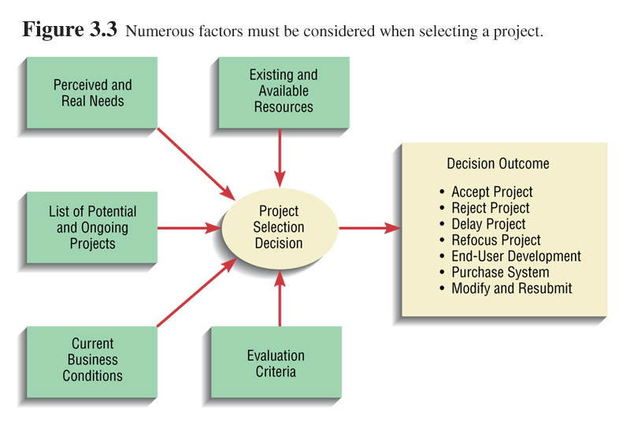
Project Selection Decision

Slide 12
Deliverables and outcomes
Primary deliverable: A schedule of specific IS development projects, coming from top-down and bottom-up sources, to move into the next part – project initiation and planning.
Outcome is: Assurance that careful consideration was given to project selection, with a clear understanding of how each project can help the organization reach its objectives.

Slide 13
2. Initiating and Planning Systems Development Projects
To transform a vague system request document into a tangible project description.
Project initiation focuses on activities that will help organize a team to conduct project planning. Among the activities performed are:
Establishing the Project Initiation Team
Establishing a Relationship with the Customer
Establishing the Project Initiation Plan
Establishing Management Procedures
Establishing the Project Management Environment and Project Workbook
Developing the Project Charter

Slide 14
Project Initiation and Planning
Project planning focuses on defining clear, discrete tasks and the work needed to complete each task
Among the activities performed are:
Describing the project scope, alternatives, and feasibility
Dividing the project into manageable tasks
Estimating resources and creating a resource plan
Developing a preliminary schedule
Developing a communication plan
Developing a project scope statement
Setting a baseline project plan

Slide 15
Initiation and Plan cont’d…
The major outcomes and deliverables from project initiation and planning are the baseline project plan and the project scope statement
The baseline project plan (BPP) contains all information collected and analyzed during the project initiation and planning activity
The project scope statement (PSS) clearly outlines what the project will deliver; work required to complete the project; the objectives of the project for the customer
PSS must be SMART( Specific, Measurable, Achievable, Relevant and Timebound) ???

Slide 16
Initiation and Plan cont’d…
The baseline project plan (BPP) contains all information collected and analyzed during the project initiation and planning activity
The plan reflects the best estimate of the project’s scope, benefits, costs, risks, and resource requirements given the current understanding of the project
BPP specifies detailed project activities for the analysis phase and less detail for subsequent project phases (why less?)
The BPP is used by the project selection committee to help decide whether the project should be accepted, redirected, or canceled.
If selected, the BPP becomes the foundation document for all subsequent SDLC activities; however, it is also expected to evolve as the project evolves.
As new information is learned during subsequent SDLC phases, the baseline plan will be updated

Slide 17
Initiation and Plan cont’d…
The project scope statement (PSS) is a short document prepared for the customer that describes what the project will deliver and outlines all work required to complete the project.
The PSS is also a useful communication tool that ensures both the analyst and the customer gain a common understanding of the project.
The PSS is consists of a high-level summary of the BPP
Depending upon your relationship with your customer, the role of the PSS may vary.
At one extreme, the PSS can be used as the basis of a formal contractual agreement outlining firm deadlines, costs, and specifications. (eg a contract programming or consulting firm)
At the other extreme, the PSS can simply be used as a communication vehicle to outline the current best estimates of what the project will deliver, when it will be completed, and the resources it may consume. (eg internal development group )

Slide 18
Initiation and Plan cont’d…
The PSS (Project Scope Statement) should be SMART, meaning it must be:
Specific: Clearly define the project's objectives.
Example: "Develop a mobile banking app for customer transactions.“
Measurable: Establish criteria to measure success.
Example: "App should handle 1,000 transactions per second.“
Achievable: Set realistic goals within resources and constraints.
Example: "Complete development with a team of 5 developers.“
Relevant: Align with business goals.
Example: "The app must increase customer engagement by 20%.“
Time bound: Set deadlines.
Example: "Launch the app within 6 months."

Slide 19
Assessing Project Feasibility
Assessing project feasibility is an important task that can be a large undertaking because it requires you to evaluate a wide range of factors affecting project success such as:
Economic
Operational
Technical
Schedule
Legal and Contractual
Political

Slide 20
Assessing Economic Feasibility
The purpose of economic feasibility study is to identify the financial benefits and costs associated with the development project
Benefits can be:
Tangible benefits ( measurable in terms of money)
Intangible benefits (not measurable)
Costs can be:
Tangible
Intangible
one-time cost (associated with dev’t and system start-up)
recurring cost (associated with the ongoing use of the system)

Slide 21
Assessing Other Feasibility Concerns
Operational feasibility: The process of assessing the degree to which a proposed system solves business problems or takes advantage of business opportunities.
Technical feasibility: The process of assessing the System’s Vendor technical ability to construct the proposed system.

Slide 22
Technical Feasibility:
The amount of technical risk associated with a given project is contingent on four primary factors.
Project size,
Project structure (are the requirements obtained easily?),
The development group’s experience with the application and technology area (standard technology than novel),
The user group’s experience with systems development projects and the application area

Slide 23
Other Feasibilities …
Schedule feasibility: The process of assessing the degree to which the potential time frame and completion dates for all major activities within a project meet organizational deadlines and constraints for effecting change.
Legal and contractual Feasibility: The process of assessing potential legal and contractual ramifications due to the construction of a system. ( e.g. E-payment systems)

Slide 24
Other Feasibilities
Political feasibility: The process of evaluating how key stakeholders within the organization view the proposed system (organizational power politics).

Slide 25
The Project Life Cycle & IS Development
The project life cycle (PLC) is a collection of logical stages or phases that maps the life of a project from its beginning to its end in order to define, build, and deliver the product of a project—that is, the information system.
Each phase should provide one or more deliverables.
A deliverable is a tangible and verifiable product of work (i.e., project plan, design specifications, delivered system, etc.).
Deliverables at the end of each phase also provide tangible benefits throughout the project and serve to define the work and resources needed for each phase.
Projects should be broken up into phases to make the project more manageable and to reduce risk.

Slide 26
PLC-phases
Defining the project goal,
Planning the project,
Executing or carrying out the project,
Closing the project, and
Evaluating the project.
Although projects follow a project life cycle, information systems development follows a product life cycle.
Project Life Cycle (PLC): Focuses on managing a specific project from start to finish, including initiation, planning, execution, and closure. It’s temporary and ends when the project is completed.
Product Life Cycle: Encompasses the entire lifespan of a product (e.g., an information system), including its development, launch, maintenance, updates, and eventual retirement. It’s ongoing and lasts until the product is no longer in use.

Slide 27
SDLC vs PLC
The SDLC is a component of the PLC, and choice of a particular approach for systems development will influence the activities, their sequence, and the estimated time to complete.
For Waterfall and Agile — determines:
The sequence of activities: For example, Waterfall follows a strict linear process, while Agile is iterative.
The time required to complete each phase: Agile’s iterative cycles may be faster in delivering functional parts, whereas Waterfall requires completing all stages before the product is delivered.
In turn, this will directly impact the project's schedule and budget.

Slide 28
Information System project management
Concerned with activities involved in ensuring that ISs are delivered on budget and on schedule and in accordance with the requirements of the organizations developing and procuring the software.
Project management is needed because software development is always subject to budget and schedule constraints that are set by the organization developing the software.

Slide 29
Project Managers
Project managers typically perform four activities, or functions: planning, scheduling, monitoring, and reporting.
Project planning includes identifying all project tasks and estimating the completion time and cost of each.
Project scheduling involves the creation of a specific timetable, Project scheduling uses Gantt charts and PERT/CPM charts, which are explained in the following sections.
Project monitoring:-The project manager must monitor the progress, evaluate the results, and take corrective action when necessary to control the project and stay on target.
Project reporting includes regular progress reports to management, users, and the project team itself.

Slide 30
Project Management activities- examples
Proposal writing.
Project planning and scheduling.
Project costing.
Project monitoring and reviews.
Personnel selection and evaluation.
Project Risk Management
Report writing and presentations.

Slide 31
Project Planning …
The project plan sets out:
The resources available to the project;
The work breakdown structure( WBS); the definition of tasks and their sequence.
A schedule for the work

Slide 32
Project scheduling
Split project into tasks and estimate time and resources required to complete each task.
Organize tasks concurrently to make optimal use of workforce.
Minimize task dependencies to avoid delays caused by one task waiting for another to complete.
Dependent on project managers intuition and experience.

Slide 33
Project management tools and techniques
Project management tools and techniques will be introduced to create:
a project network plan that defines the sequence of activities throughout the project and their dependencies.
These tools include:
Gantt charts, Network diagrams (activity on the node-AON), critical path analysis, PERT(Program Evaluation and Review Technique)/CPM( Critical Path Method),
Gantt Chart shows the general sequence of activities or project tasks.
useful for tracking and monitoring the progress of a project
It does not show the explicit relationships among tasks or activities.
Most project managers find that PERT/CPM charts, which are discussed in the following section, are better tools for managing large projects
PERT/CPM :-use AoN for task pattern analysis.

Slide 34
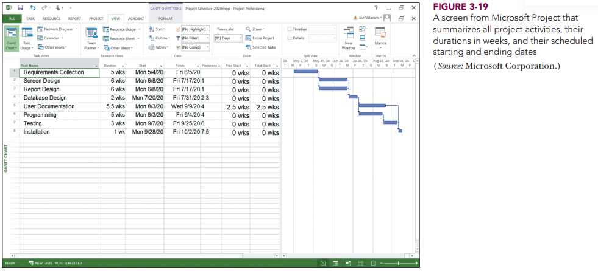
Gantt Chart

Slide 35
Project management tools and techniques
Project network diagrams provides valuable information about the logical sequence and dependencies among the various activities or tasks.
Project network diagrams provide information concerning when specific tasks must start and finish, and what activities may be delayed without affecting the deadline target date.
In addition, the project manager can make decisions regarding scheduling and resource assignments to shorten the time required for those critical activities that will impact the project deadline.

Slide 36
Work Breakdown Structure (WBS)
A work breakdown structure (WBS) involves breaking a project down into a series of smaller tasks.
A task, or activity, is any work that has a beginning and an end and requires the use of company resources such as people, time, or money.

Slide 37
Project Management Tools …
Activity on the Node (AON) is a project network diagramming tool that graphically represents all of the project activities and tasks, as well as their logical sequence and dependencies.
Using AON, activities are represented as boxes (i.e. nodes) and arrows indicate precedence and flow.

Slide 38
Project Management Tools …
To construct an AON network diagram,
Begin with the activities and tasks with associated time estimate.
The next step is to determine which activities are predecessors, successors, or parallel.
Predecessor activities are those activities that must be completed before another activity can be started
e.g., a computer's operating system must be installed before loading an application package.
Successor activities are activities that must follow a particular activity in some type of sequence.
For example, a program must be tested and then documented after it is compiled.
A parallel activity is an activity or task that can be worked on at the same time as another activity.
Parallel activities may be thought of as an opportunity to shorten the project schedule; however, they also can be a trade-off since doing more than one thing at the same time can have a critical impact on project resources.

Slide 39
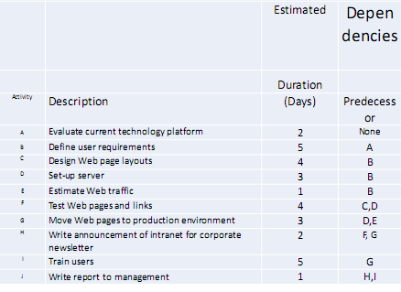

Slide 40
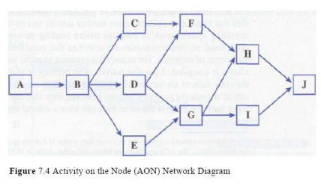
Activity on Node (AoN) Network Diagram

Slide 41
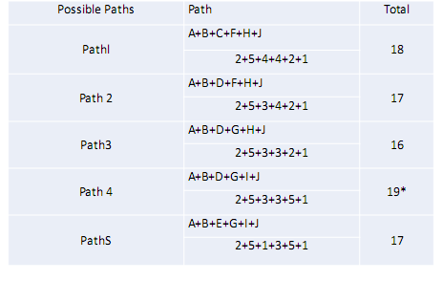
Possible Activity Paths

Slide 42
Critical Path
A critical path is a series of tasks which, if delayed, would affect the completion date of the overall project.
If any task on the critical path falls behind schedule, the entire project will be delayed
PERT/CPM use critical path Method to monitor Project Schedule

Slide 43
Program Evaluation and Review Technique (PERT)
PERT uses the project network diagramming technique to create a visual representation of the scheduled activities that expresses both their logical sequence and interrelationships.
PERT also uses a statistical distribution that provides probability for estimating when the project and its associated activities will be completed.
This probabilistic estimate is derived by using three estimates for each activity: optimistic, most likely, and pessimistic.
An optimistic estimate is the minimum time in which an activity or task can be completed.
This is a best-case scenario where everything goes well and there is little or no chance of finishing earlier.
A most likely estimate is the normally expected time required to complete the task or activity.

Slide 44
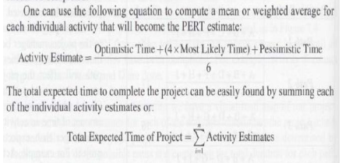
Activity and Project time Estimates for PERT

Slide 45
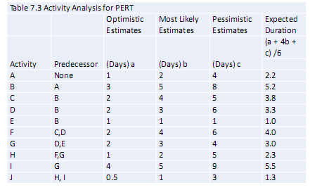
Activity Analysis for PERT

Slide 46
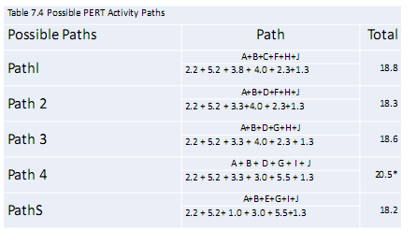
Possible PERT Activity Paths

Slide 47
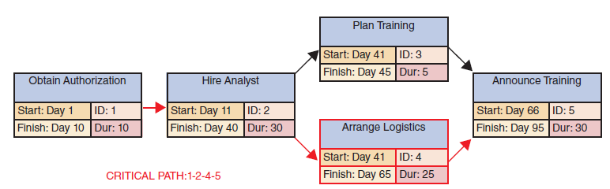
Example of a PERT/CPM chart with five tasks.
Task 2 is a dependent task that has multiple successor tasks. Task 5 has multiple predecessor tasks.
Identify the Critical Path for the Examples in the previous slides

Slide 48
Risk management
Risk management is concerned with identifying risks and drawing up plans to minimize their effect on a project.
A risk is a probability that some adverse circumstance will occur. Can be of 3 Categories
Project risks affect schedule or resources of the project;
Product risks affect the quality or performance of the software being developed;
Business risks affect the organization developing or procuring the software.

Slide 49
The Risk Management Process
Risk identification
Identify project, product and business risks;
Risk analysis
Assess the likelihood and consequences of these risks;
Risk planning
Draw up plans to avoid or minimize the effects of the risk;
Risk monitoring
Monitor the risks throughout the project;

Slide 50
Risk analysis
Assess probability and seriousness of each risk.
Probability may be very low, low, moderate, high or very high.
Risk effects might be catastrophic, serious, tolerable or insignificant.

Slide 51
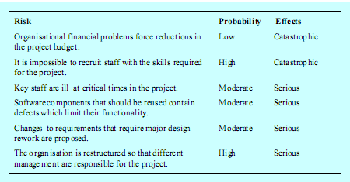
Risk analysis (i)

Slide 52
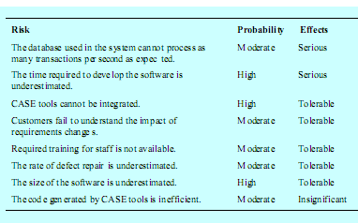
Risk analysis (ii)

Slide 53
Risk planning
Consider each risk and develop a strategy to manage that risk.
Avoidance strategies
The probability that the risk will arise is reduced;
Minimization strategies
• The impact of the risk on the project or product will be reduced;
Contingency plans
If the risk arises, contingency plans are plans to deal with that risk;

Slide 54
Risk monitoring
Assess each identified risks regularly to decide whether or not it is becoming less or more probable.
Also assess whether the effects of the risk have changed.
Each key risk should be discussed at management progress meetings.

Slide 55
Project Risk
Risks that could affect the successful completion of a specific project, typically
Schedule Risk: Delays in project timelines due to resource constraints, poor planning, or external factors.
Cost Risk: Project costs exceed budget expectations due to unforeseen expenses or inaccurate estimates.
Scope Risk: The project’s scope may expand beyond its original boundaries (scope creep), requiring more resources or time.
Resource Risk: Insufficient human, technological, or material resources to complete the project.
Quality Risk: Compromises in project deliverables' quality due to rushed timelines or inadequate specifications

Slide 56
Project Risk Management
Management Strategies
Risk Identification: Create a risk register to track potential project risks.
Risk Assessment (Risk analysis): Evaluate the likelihood and impact of each risk. Probability may be very low, low, moderate, high or very high. Risk effects might be catastrophic, serious, tolerable or insignificant
Mitigation Plans: Develop strategies to minimize or respond to high-priority risks.
Contingency Planning: Set aside resources or buffer time to deal with unforeseen risks

Slide 57
Product Risk
Product Risk could affect developing, launching, and maintaining a product. Such risks might arise from technical challenges, market conditions, or user experience issues.
Technical Risk: Failures in product development due to technological challenges, bugs, or integration issues.
Market Risk: The product may not meet market demands, leading to poor sales or adoption.
Compliance Risk: Failing to meet industry standards, safety regulations, or legal requirements.
Supply Chain Risk: Disruptions in obtaining materials, components, or manufacturing services.
User Experience Risk: Poor usability or failure to meet user expectations.

Slide 58
Product Risk Management
Management Strategies
Market Research: Conduct thorough market analysis and user feedback during product development.
Prototyping and Testing: Use iterative development cycles with frequent testing to catch technical and UX issues early.
Quality Assurance: Implement robust QA processes and testing.
Regulatory Compliance: Ensure compliance with relevant laws and regulations from the start of development.
Supplier and Vendor Management: Establish backup suppliers or agreements to minimize supply chain disruptions.

Slide 59
Business Risk
Business risk takes a broader view, focusing on risks that affect the entire organization. These risks can be financial, operational, strategic, or reputational.
Financial Risk: Cash flow problems, bad investments, or market downturns that can impact profitability.
Operational Risk: Internal process failures, IT disruptions, or operational inefficiencies.
Strategic Risk: Poor decision-making or strategy misalignment with market trends or customer needs.
Reputational Risk: Damage to the company's public image due to product failures, scandals, or negative press.
Cybersecurity Risk: Threats from data breaches, hacking, or other cyber-attacks.

Slide 60
Business Risk Management
Management Strategies:
Diversification: Spread investments and business activities to mitigate the impact of a downturn in any one area.
Operational Resilience: Build systems that can quickly recover from disruptions (e.g., backup systems, crisis management plans).
Strategic Planning: Regularly review and adjust business strategy based on market conditions, competition, and consumer needs.
Insurance: Use various types of insurance to safeguard against unforeseen losses.
Reputation Management: Monitor public perception and engage in proactive communication during crises.

Slide 61
Summary
Project planning involves defining clear, discrete activities and the work needed to complete each activity within a single project.
It often requires you to make numerous assumptions about the availability of resources such as hardware, software, and personnel.
It is much easier to plan nearer-term activities than those occurring in the future.
longer-term plans are more general in scope and nearer-term plans that are more detailed.
The repetitive nature of the project management process requires that plans be constantly monitored throughout the project and periodically updated (usually after each phase), based upon the most recent information.

Slide 62
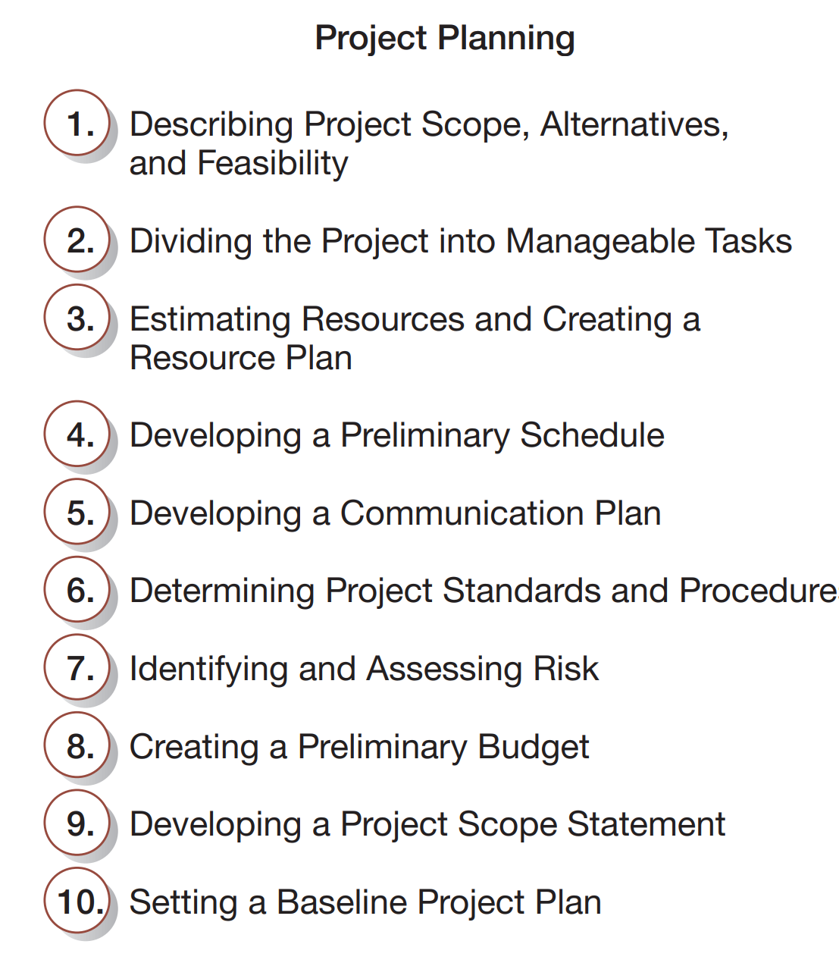
Activities performed during project planning summarized

Slide 63
Case study (Homework)
Study the following (text book pages indicated) based on the case study presented
P73: Project charter
P138: System service request
P139: Economic Feasibility
P150: Baseline project plan
P152: Project scope statement

Slide 64
End of Chapter Two

